Slide 1
Case study on Ecommerce Website
Capgemini Technology Services India Limited
Presented by-
Tanu Srivastava
Batch-3
Employee Id- 46235372

Slide 2
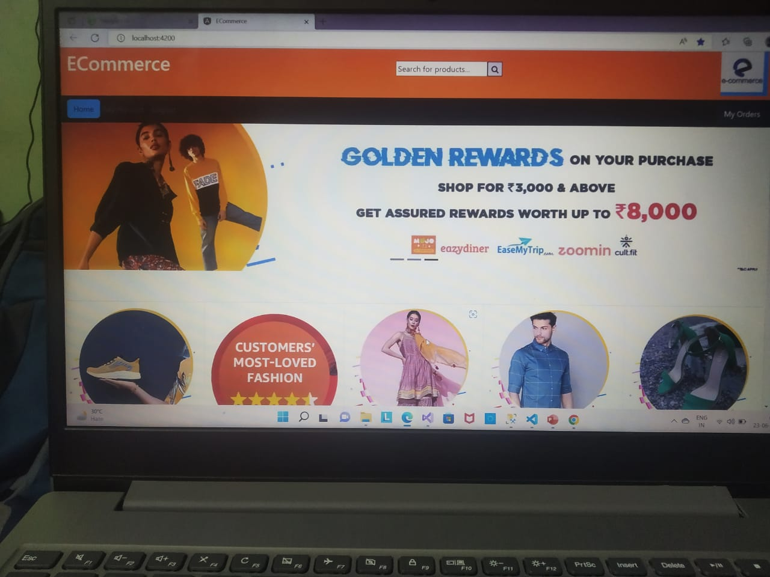
Contents
Overview
Data flow in
Website
Some useful
diagrams
References

Slide 3
Overview
Ecommerce website has been created by using following applications-
Microsoft SQL Server Management Studio,
Microsoft Visual Studio
Visual Studio Code

Slide 4
Data flow in website
DataBase
(Microsoft SQL Server Management Studio)
cWeb Api
(Microsoft Visual Studio)
Ecommerce Web App
(Visual Studio Code)

Slide 5
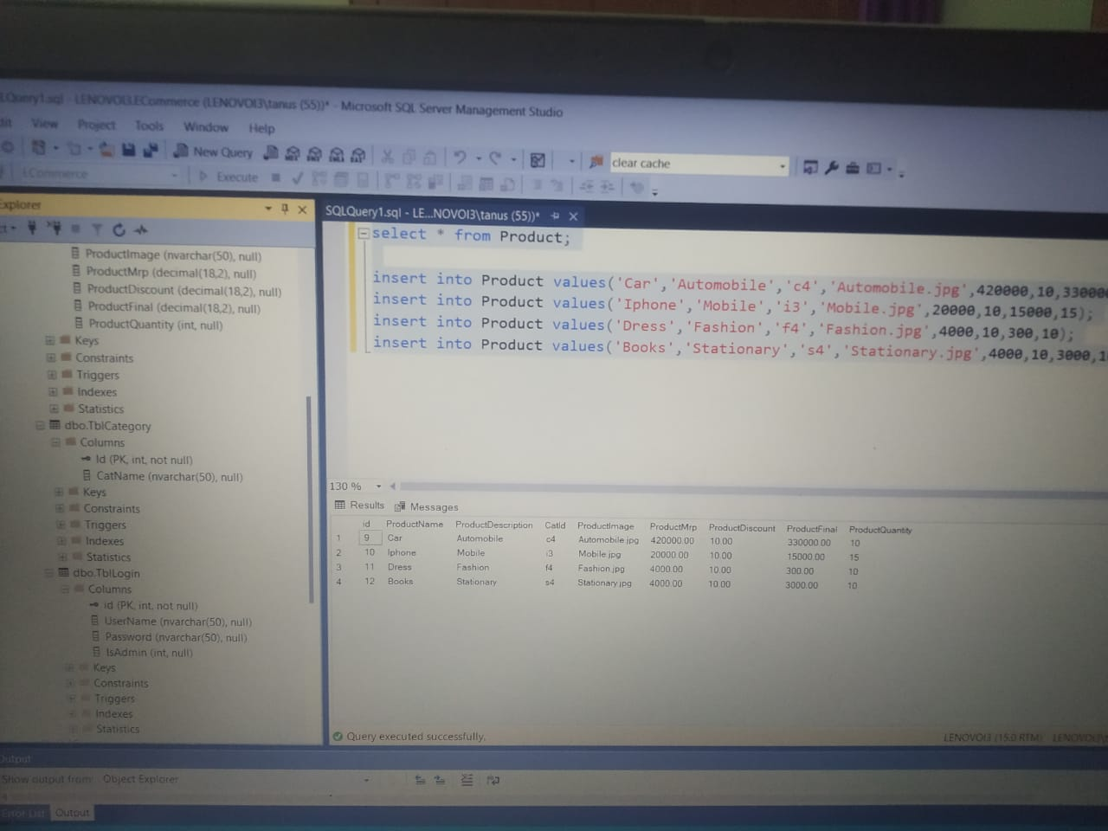
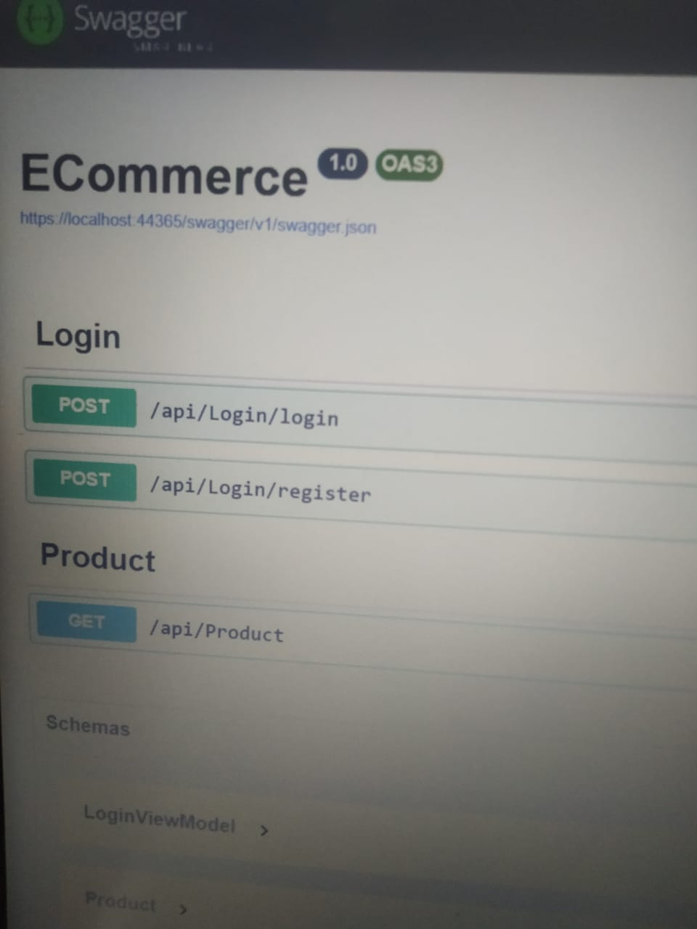
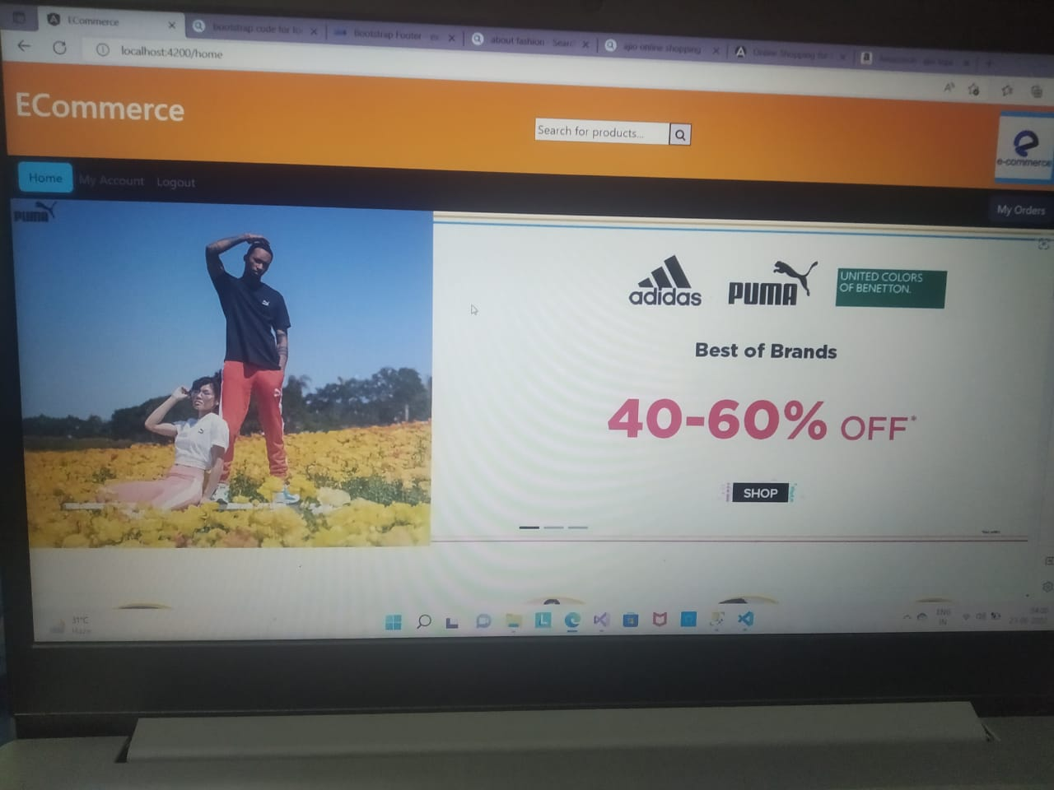
Some Useful diagrams

Slide 6
References
Bootstrap
E-commerce websites

Slide 7
Thank you

